Slide 1
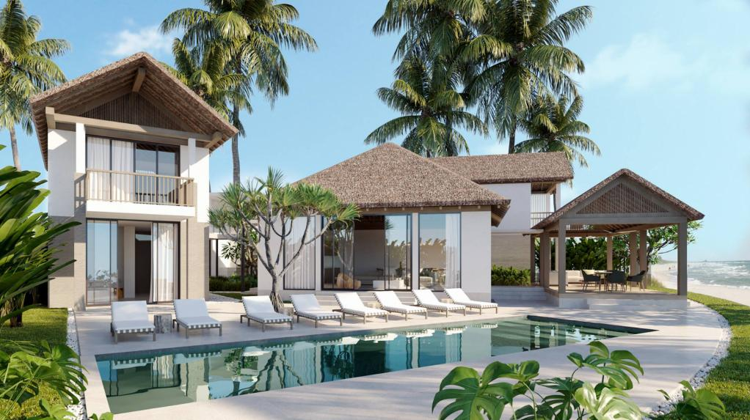
HOTEL RESERVATION ANALYSIS
Using Structured Query Language

Slide 2

z
Problem Statement
The hotel industry relies on data to make informed decisions and provide a better guest experience. In this project, I worked with a hotel reservation dataset to gain insights into guest preferences, booking trends, and other key factors that impact the hotel's operations. I used SQL to query and analyze the data, as well as answered specific questions about the dataset.

Slide 3
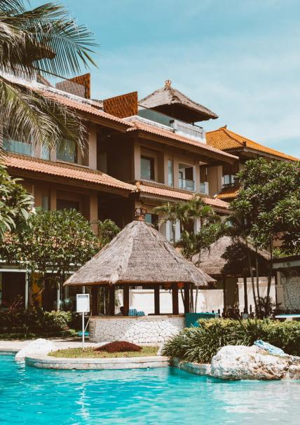
About the Dataset
The dataset includes the following columns:
Booking_ID : A unique identifier for each hotel reservation.
no_of_adults : The number of adults in the reservation.
no_of_children : The number of children in the reservation.
no_of_weekend_nights : The number of nights in the reservation that fall on weekends.
no_of_week_nights : The number of nights in the reservation that fall on weekdays.
type_of_meal_plan : The meal plan chosen by the guests.
room_type_reserved : The type of room reserved by the guests.
lead_time : The number of days between booking and arrival.
arrival_date : The date of arrival.
market_segment_type : The market segment to which the reservation belongs.
avg_price_per_room : The average price per room in the reservation.
booking_status : The status of the booking.

Slide 4
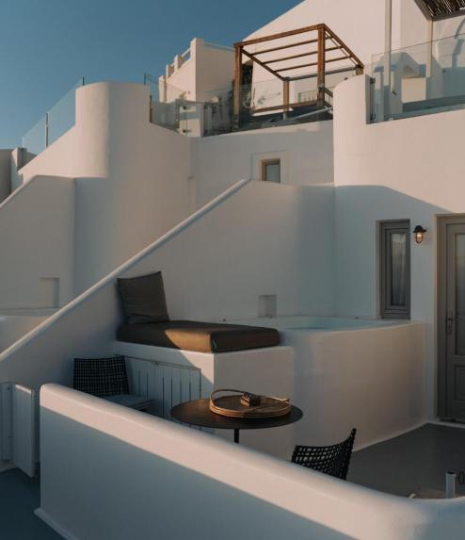

Overview of Analysis
Reservation Statistics and Trends:
Total number of reservations.
Yearly and monthly reservation trends.
Weekend reservations and duration insights.
Guest Preferences:
Most popular meal plans and room types.
Common market segments and booking status details.
Financial Analysis:
Average room prices, especially for reservations involving children.
Market segments generating the highest average room prices.
Demographic Insights:
Total number of adults and children across all reservations.
Room type preferences and average prices for families with children.
Operational Metrics:
Lead time variations (highest and lowest).
Average number of nights spent by guests per room type.

Slide 5
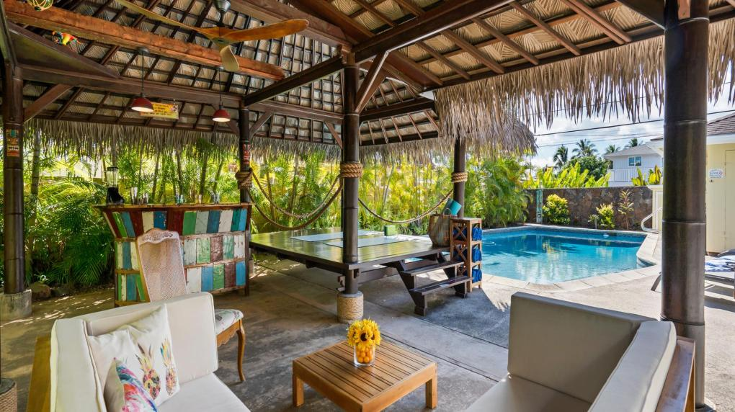


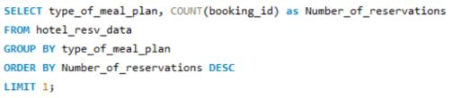

Total number of Reservations
Query
Output
In totality, there are 700 number of reservations done
Most popular meal plan among guests
Query
Output
Meal Plan 1 stands out to be the Most popular meal plan, with 527 reservations count

Slide 6
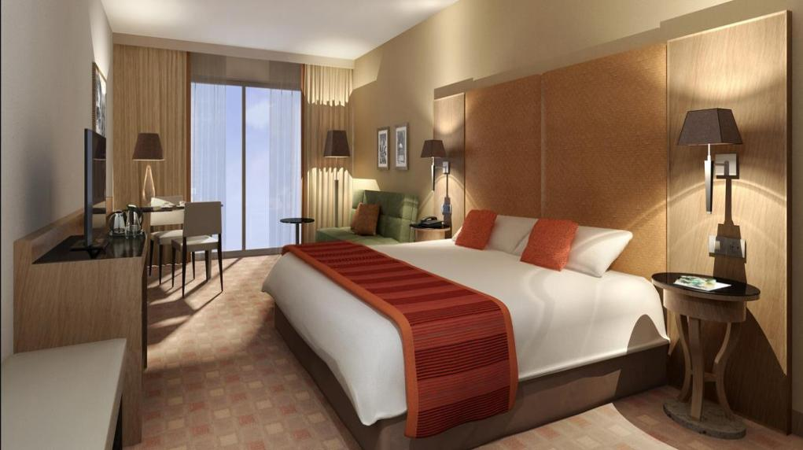


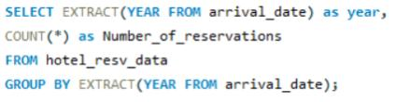

Average price per room for reservations involving Children
Query
Output
Average price per room for reservations involving Children is 144.57
Reservations made over different years
Query
Output
Number of reservations for the year 2017 were 123 and for the year 2018 were 577

Slide 7
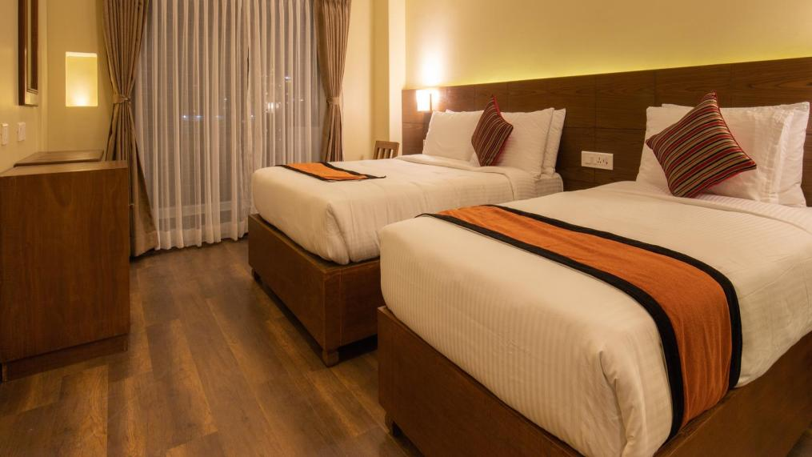
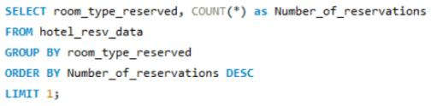



Most commonly booked Room type
Query
Output
Most commonly booked type is Room Type 1, with 534 reservations
Reservations falling on weekends
Query
Output
A total of 383 reservations were made on weekends

Slide 8
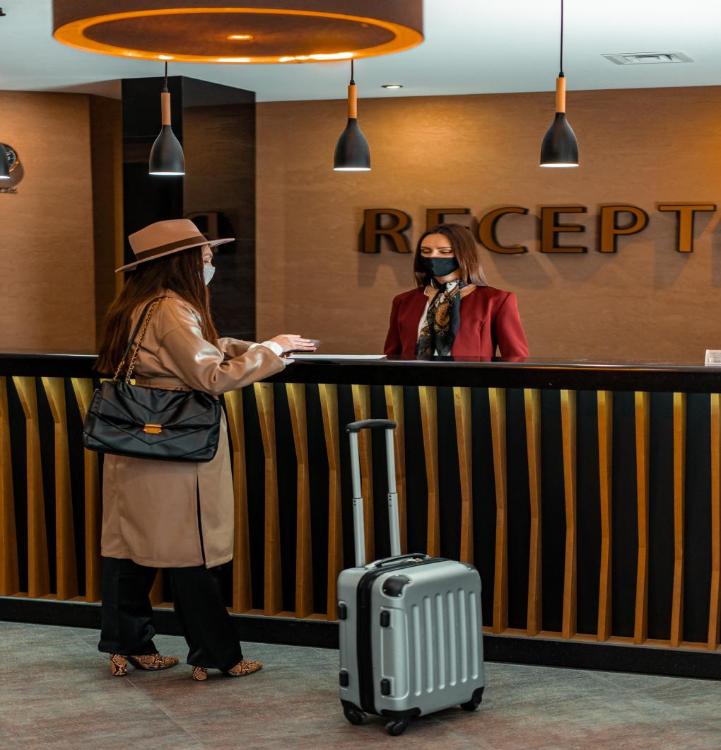


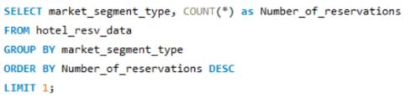

Highest and Lowest lead time for reservations
Query
Output
Highest lead time for reservations is 443 days and lowest time is 0 days
Most common Market segment type for reservations
Query
Output
Most common market segment type for reservations is Online, with 518 reservations

Slide 9
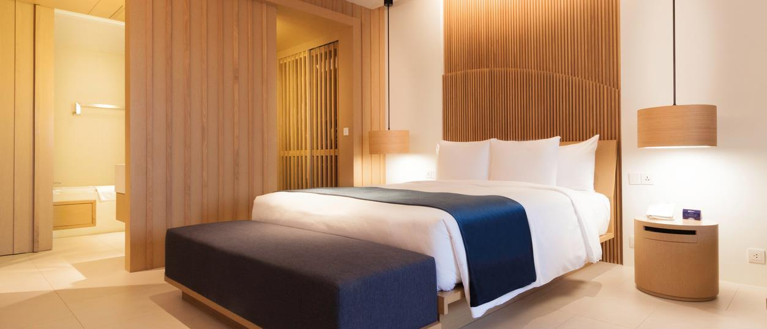




Reservations have a booking status of ‘Confirmed’?
Query
Output
There are no bookings with status ‘Confirmed’, but we have 493 bookings with status as ‘Not Cancelled’
Total number of adults and children across all reservations
Query
Output
Total number of adults are 1316 and children are 69, both combined we have 1385

Slide 10


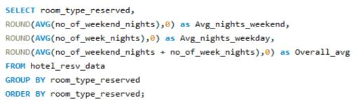
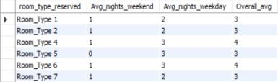
Average number of weekend nights reserved involving children
Query
Output
Average number of weekend nights reserved involving children is 1
Average number of nights spent by guests for each room type
Query
Output
The output shows average number of nights spent for each room type, both on Weekdays and Weekends, and also on both combined

Slide 11
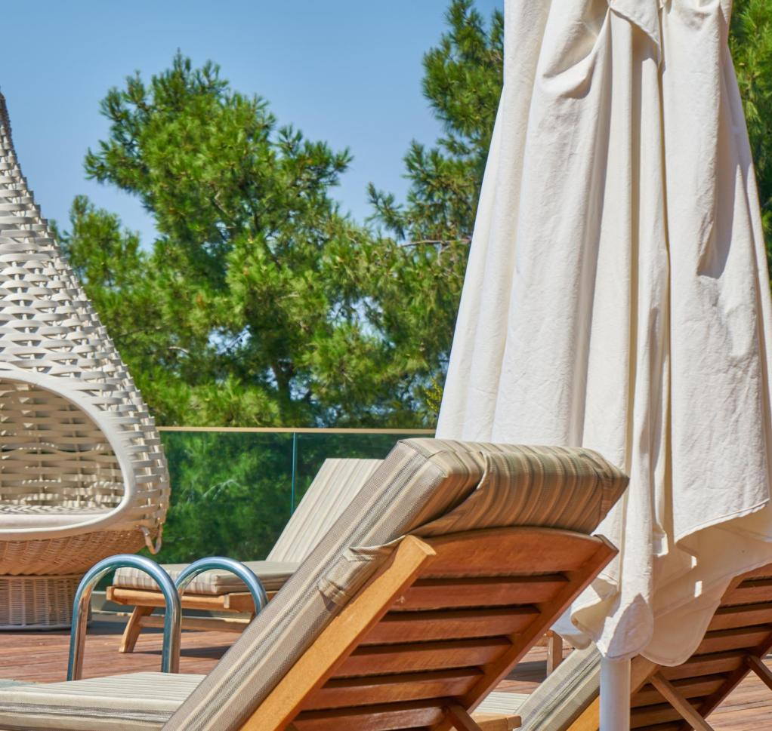
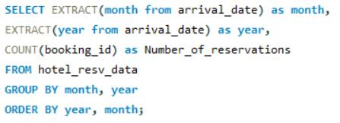
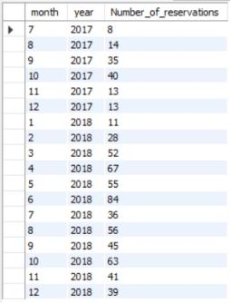
Reservations made in each month of the year
Query
Output
The output shows, Year-month wise total reservations made. We observe that, June 2018 has received most number of reservations of 84, and July 2017 has the least number of reservations of 8

Slide 12
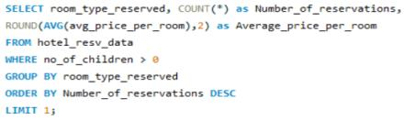

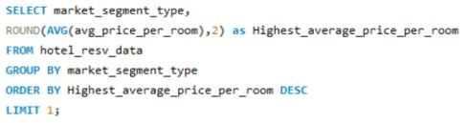

Most common room type, involving children and it’s Average price
Query
Output
Most common room type with children is Room type 1, with a an average price room of 123.12
Market segment type with highest average price per room
Query
Output
Market segment type with highest average price per room is Online, with a price of 112.45

Slide 13
Summary of Findings:
Total Reservations: 700
Most Popular Meal Plan: Meal Plan 1 with 527 reservations
Average Price for Reservations Involving Children: $144.57 per room
Yearly Reservations: 123 in 2017 and 577 in 2018
Most Commonly Booked Room Type: Room Type 1 with 534 reservations
Weekend Reservations: 383
Lead Time for Reservations: Highest is 443 days, lowest is 0 days
Most Common Market Segment: Online with 518 reservations
Booking Status: 493 bookings with status as ‘Not Cancelled’ (no ‘Confirmed’ bookings)
Total Guests: 1316 adults and 69 children (1385 total)
Average Weekend Nights with Children: 1
Monthly Reservations: Highest in June 2018 with 84, lowest in July 2017 with 8
Most Common Room Type with Children: Room Type 1 with an average price of $123.12
Highest Average Price by Market Segment: Online with $112.45 per room

Slide 14

z
THANK YOU

